Slide 1
REVIEW OF MINI PROJECT
For E3 2018 Admitted Batch
Submitted as part of mini project
Kona Shanmukha Sai S180847
Dasari Divya S180559
Ucchula Sireesha S180777
UNDER THE SUPERVISION OF :
MR. G.S.R SASTRY (M.TECH, P.H.D)
Department of Computer Science and Engineering
Rajiv Gandhi University of Knowledge Technologies
Srikakulam - 532402

Slide 2
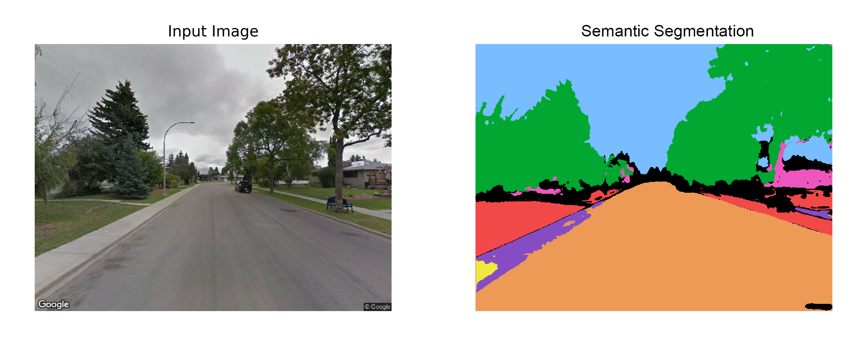
SEMANTIC SEGMENTATION OF PIXEL USING FULLY CONVOLUTIONAL NEURAL NETWORKS
Project Title

Slide 3
ABSTRACT:
The promising uses of a semantic segmentation model developed using the KITTI Road dataset are highlighted in this abstract. A better grasp of the picture is made possible by the model's capacity to classify individual pixels in photos of roads and lanes. The model provides precise pixel-level categorization by utilizing a Fully Convolutional Network (FCN) architecture. Although handling shadows, crossroads, and objects presented some difficulties, the performance of the model has room for growth through additional developments such scaling factors for skip connections. This semantic segmentation model shows tremendous potential for a variety of sectors, particularly in the area of autonomous driving, thanks to its capacity to precisely segment and identify objects in road situations.

Slide 4
INTRODUCTION:
Semantic segmentation is a computer vision task that involves assigning a specific class label to each pixel in an image, thereby dividing the image into different regions based on their semantic meaning. Fully Convolutional Neural Networks (FCNNs) have proven to be highly effective in tackling this task.The use of FCNNs for semantic segmentation has led to significant advancements in various applications, including autonomous driving, medical image analysis, scene understanding, and object recognition

Slide 5
PROBLEM STATEMENT:
The problem at hand is the lack of accurate and precise semantic segmentation for road and lane images. Existing methods struggle to classify individual pixels effectively, resulting in inaccurate segmentation and limited understanding of road scenes. This poses challenges in domains like autonomous driving, where reliable segmentation is essential for object detection and obstacle avoidance. The objective of this project is to develop a semantic segmentation model that accurately classifies pixels in road and lane images while effectively addressing these challenges. The aim is to enhance understanding and enable improved autonomous driving systems and other applications relying on precise image segmentation.

Slide 6
Existing System:
The existing system involves traditional recognition networks, including LeNet, AlexNet, and VGG nets, which are originally designed for image classification tasks. These networks take fixed-sized inputs and produce nonspatial outputs, making them unsuitable for dense prediction tasks like semantic segmentation.

Slide 7
Proposed System:
The proposed system introduces fully convolutional networks (FCNs) as an improvement over the existing system. FCNs convert classification networks into dense prediction models by transforming fully connected layers into convolutional layers. This allows the network to accept inputs of any size and produce spatially dense prediction maps.
The proposed system incorporates skip connections to combine information from different layers, enabling the refinement of segmentation output at various scales. The FCN architecture allows for efficient end-to-end learning for dense prediction tasks, such as semantic segmentation.

Slide 8
IMPLEMENTATION:
The implementation of Fully Convolutional Networks (FCNs) involves adapting existing classification networks by replacing their fully connected layers with convolutional layers to enable handling inputs of any size and producing dense classification maps. Skip connections are added to combine coarse semantic information from higher layers and local appearance information from lower layers. The shift-and-stitch trick is used to obtain dense predictions by downsampling the outputs, shifting the input image, applying convolution on multiple inputs, and interlacing the predictions. Upsampling is achieved by converting pooling layers to have an input stride of 1 and adjusting filters based on the upsampling factor. Patchwise training is employed by sampling patches within each image to create training batches, excluding certain patches from gradient computation to speed up learning, and correcting class imbalance. These techniques collectively enable accurate semantic segmentation for road and lane images.

Slide 9
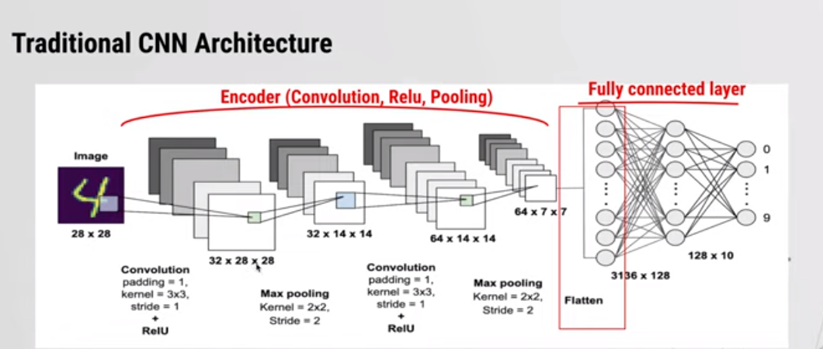

Slide 10
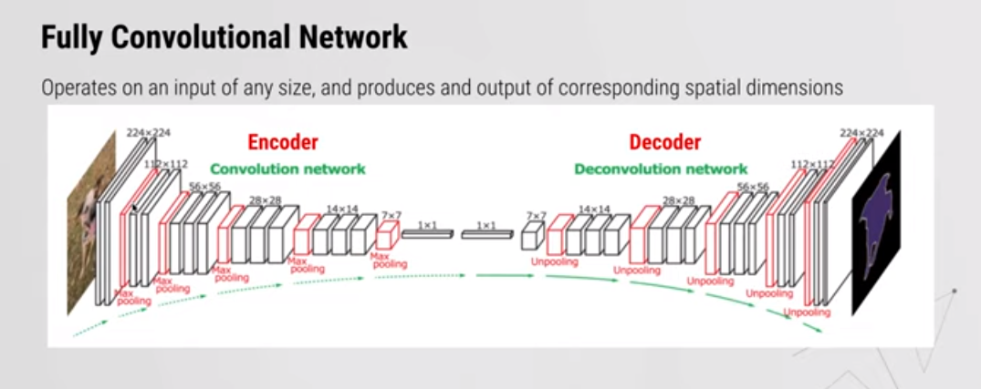

Slide 11
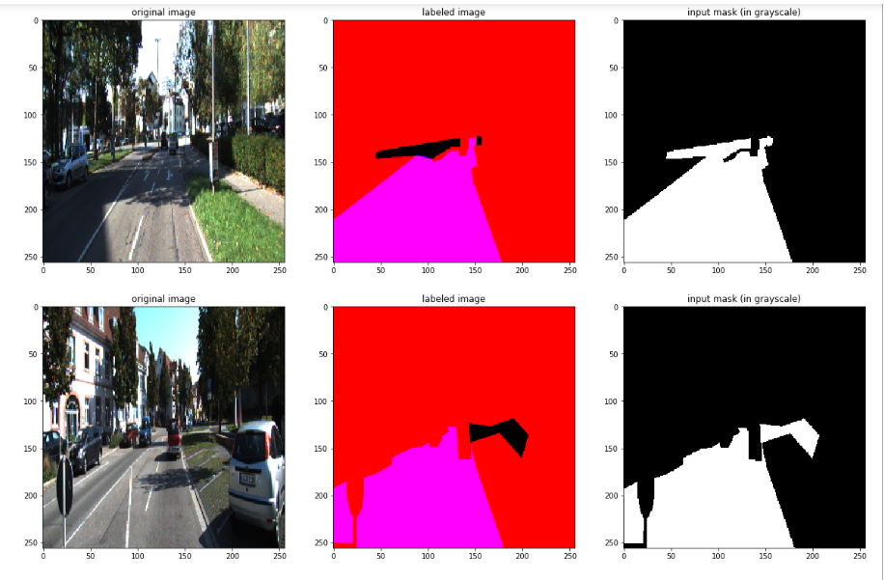
RESULTS:

Slide 12
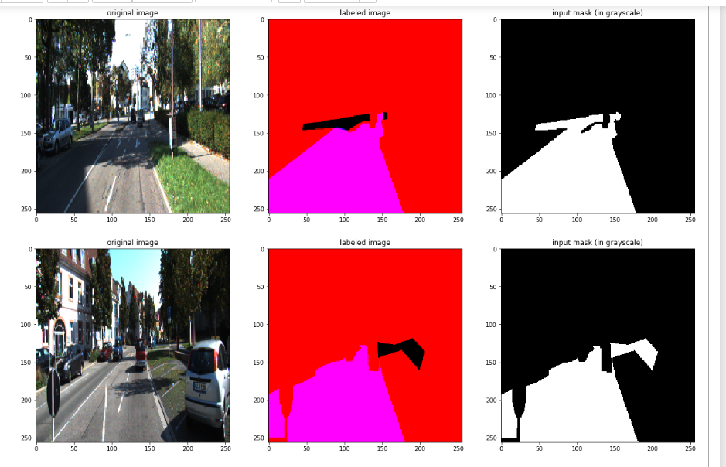

Slide 13
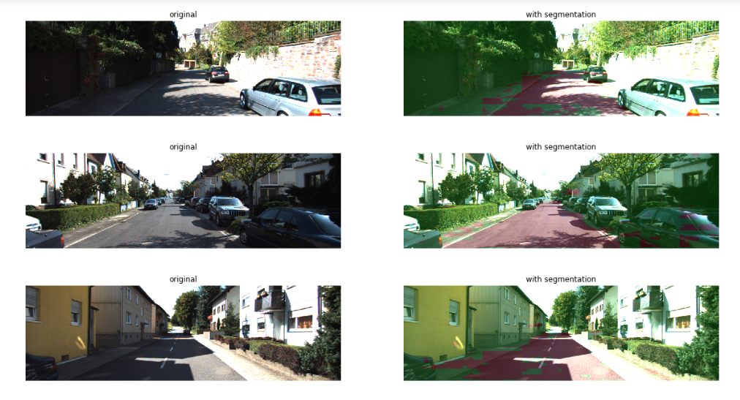

Slide 14
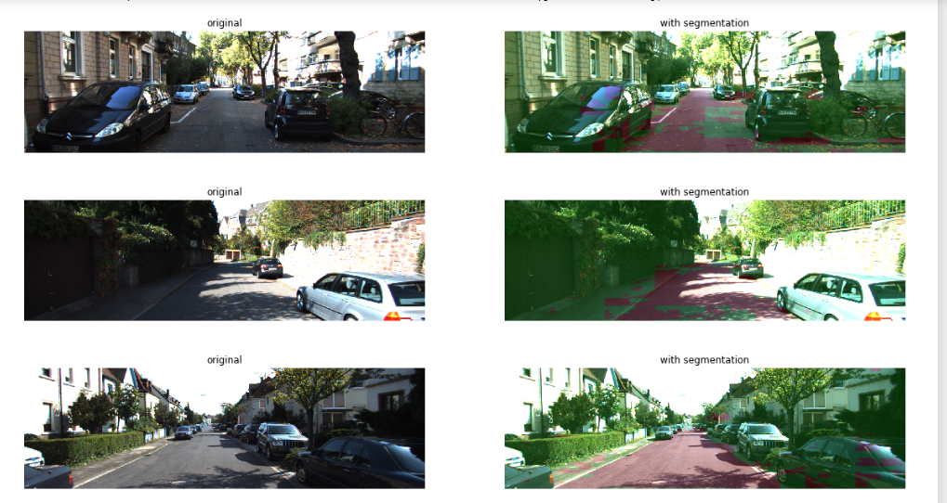

Slide 15
Performance Metrics:
The table below summarizes the performance metrics achieved by each approach:
Model IoU (%) mIoU (%) Pixel Accuracy (%)
FCN (Proposed) 84.5 71.3 92.1
U-Net 78.2 63.8 90.5
DeepLabv3+ 82.7 74.6 91.5

Slide 16
CONCLUSION:
The semantic segmentation model based on FCN demonstrates tremendous potential for various sectors, particularly in autonomous driving. With its capacity to precisely segment and identify objects in road situations, this model can contribute significantly to the advancement of autonomous vehicles and related technologies.Continued research and development in this field can further refine the model's performance and expand its applicability in real-world applications.

Slide 17
THANK YOU

